Slide 2
The REGIOSTARS
Since 2008, the European Commission hands out annual REGIOSTARS awards to EU-funded projects which demonstrate excellence and new approaches in regional development.
Awards in five thematic categories (smart, sustainable and inclusive growth, urban development and a topic of the year) plus Public Choice award
Independent jury of high-level academics
Ceremony during Week of Regions and Cities in October

Slide 3
The 2019 Edition
Five thematic categories announced on 19 February
Online platform: ec.europa.eu/regiostars
Application period: 19 February – 9 May 2019
Finalists determined by July 2019
Meeting with Commissioner in July
Videos for the finalist will be produced during summer

Slide 4
Conditions
Maximum FIVE projects per programme (ERDF, CF, ESF, IPA, ENI) from the periods 2007-2013 and 2014-2020
Endorsement letter of the relevant managing authority
Reference to one of the five award categories
Level of maturity and results should be ensured

Slide 5
Award criteria
Innovative character of the project in the selected award category.
Good results and impact of the project in relation to its initial objectives and impacts.
Financial sustainability of the project
Transferability and possibility to replicate the project in other regions

Slide 6
Award categories 2019
Smart growth - Promoting digital transformation
Sustainable growth - Connecting green, blue and grey
Inclusive growth - Combatting inequalities and poverty
Urban development - Building climate-resilient cities
Topic of the year 2019 - Modernising health services

Slide 7
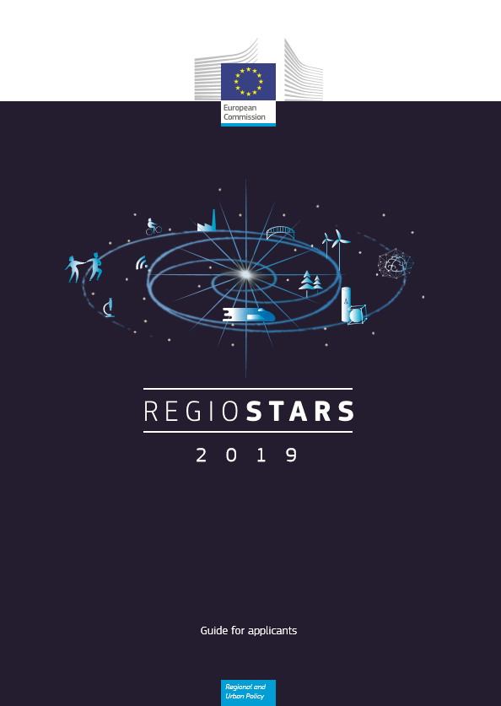
Communication material
Online: ec.europa.eu/regiostars
‘Guide for Applicants’ with
Description of award categories 2019
Eligibility and award criteria
Practical guidance to the REGIOSTARS 2019
Printed: Postcards and posters
Visuals for presentations and social media

Slide 8
ec.europa.eu/regiostars

